Slide 1
Learning & Behavior
Numera Younus

Slide 2
Contents
What is learning
Classical conditioning
Operant conditioning
Modelling

Slide 3
What is Learning?
Learning may be defined as a relatively permanent change in behavior that occurs as a result of experience.
Not temporary
Change is not always immediately apparent
Not due to biological factors, drugs, etc.
Any process through which experience at one time can alter an individual's behavior at a future time.
(Peter Gray)

Slide 4
Conditioning is a type of learning that links some sort of stimulus to a human behavior or response.

Slide 5
Classical conditioning

Slide 6
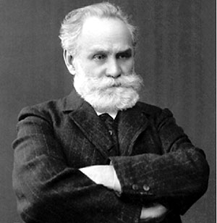
Classical Conditioning
It is a form of associative learning that was first demonstrated by Ivan Pavlov.
The study of classical conditioning began in the 20th century, when Ivan Pavlov, a Russian psychologist turned his attention to learning.

Slide 7
What is Classical Conditioning?
A learning process in which a previously neutral stimulus becomes associated with another stimulus through repeated pairing with that stimulus.
Classical conditioning theory involves learning a new behavior via the process of association.
In simple terms two stimuli are linked together to produce a new learned response in a person or animal.

Slide 8
Terminology and procedures
Responses controlled through classical conditioning are said to be elicited.
Classical conditioning begins with an unconditioned stimulus (UCS) that elicits an unconditioned response (UCR).
Then a neutral stimulus is paired with the UCS until it becomes a conditioned stimulus (CS) that elicits a conditioned response (CR).

Slide 9
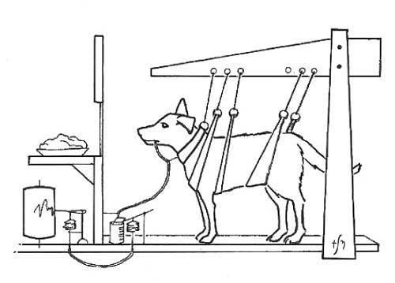
Pavlov’s Experiment
In his initial experiment, Pavlov used bells to call the dogs to their food and, after a few repetitions, the dogs started to salivate in response to the bell.
Thus, a neutral stimulus (bell) became a conditioned stimulus (CS) as a result of consistent pairing with the unconditioned stimulus (US - meat powder in this example).
Pavlov referred to this learned relationship as a conditional reflex (now called Conditioned Response).

Slide 10
There are three stages to classical conditioning. In each stage the stimuli and responses are given special scientific terms

Slide 11
Stage 1: Before Conditioning
In this stage, the unconditioned stimulus (UCS) produces an unconditioned response (UCR) in an organism.
In basic terms this means that a stimulus in the environment has produced a behavior / response which is unlearned (i.e. unconditioned) and therefore is a natural response which has not been taught.
This stage also involves another stimulus which has no affect on a person and is called the neutral stimulus (NS).
The neutral stimulus does not produce a response until it is paired with the unconditioned stimulus.

Slide 12
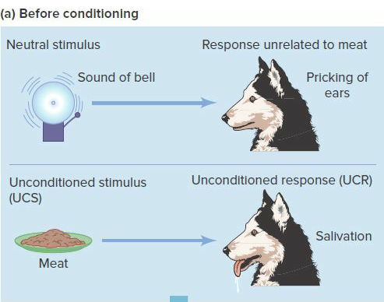

Slide 13
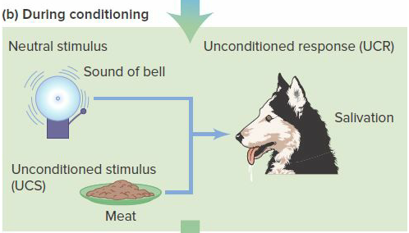
Stage 2: During Conditioning
During this stage a stimulus which produces no response (i.e. neutral) is associated with the unconditioned stimulus at which point it now becomes known as the conditioned stimulus (CS).

Slide 14
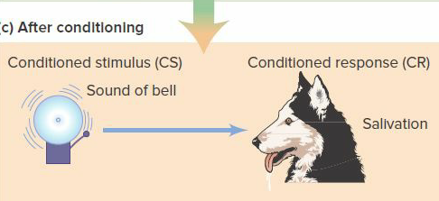
After Conditioning
Now the conditioned stimulus (CS) has been associated with the unconditioned stimulus (UCS) to create a new conditioned response (CR).

Slide 15
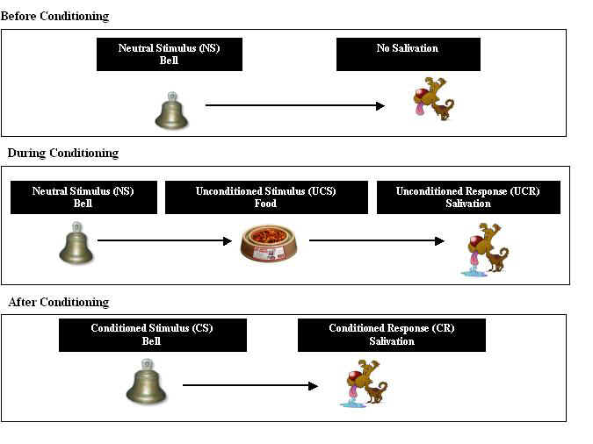

Slide 16
Acquisition occurs when a CS and UCS are paired, gradually resulting in a CR (bell + food → salivation).
Acquisition depends on stimulus contiguity which is a temporal association between events.
Extinction occurs when a CS is repeatedly presented alone until it no longer elicits a CR.
Spontaneous recovery is the reappearance of an extinguished response after a period of non exposure to the CS

Slide 17
Generalization occurs when a CR is elicited by a new stimulus that resembles the original CS as in Watson and Rayner’s study of little Albert. (e.g. Look-Alike Packaging, Child saying thank you)
Discrimination occurs when a CR is not elicited by a new stimulus that resembles the original CS (e.g. different packaging for brand, differentiate between a howling dog and a dog wagging his tail)

Slide 18
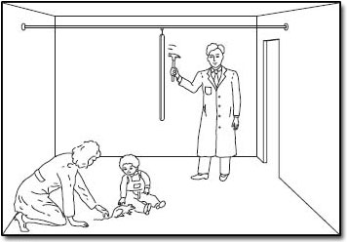

Slide 19
Learning in Humans
Aversions to particular foods
Bee stings association with pain
Punishment associated with “the look” from mother
Pleasant experiences.
For instance, you may have a particular fondness for the smell of a certain perfume or aftershave lotion because thoughts of an early love come rushing back whenever you encounter it. Or hearing a certain song can bring back happy or bittersweet emotions due to associations that you have developed in the past.

Slide 20
Operant conditioning
Also called instrumental conditioning as the organism’s behavior is instrumental in producing the outcome

Slide 21
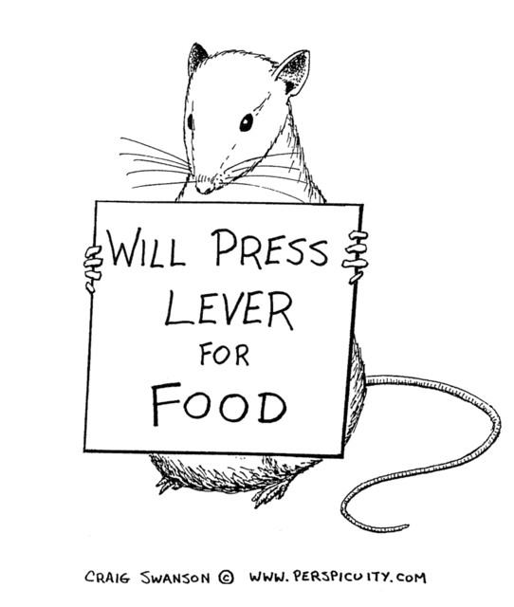
Description
Definition: Operant conditioning is a type of learning in which responses come to be controlled by their consequences.
Operant conditioning is a method of learning that occurs through rewards and punishments for behavior.
Through operant conditioning, an association is made between a behavior and a consequence for that behavior.
Sometimes referred to as instrumental conditioning.

Slide 22
E. L. Thorndike’s work on Instrumental learning and the law of effect provided the foundation for the study of operant conditioning.
It was pioneered by B. F. Skinner who showed that rats and pigeons tend to repeat responses that are followed by favorable outcomes
Operant conditioning mainly regulates voluntary, spontaneous responses such as studying, going to work, telling jokes, and asking someone out.

Slide 23
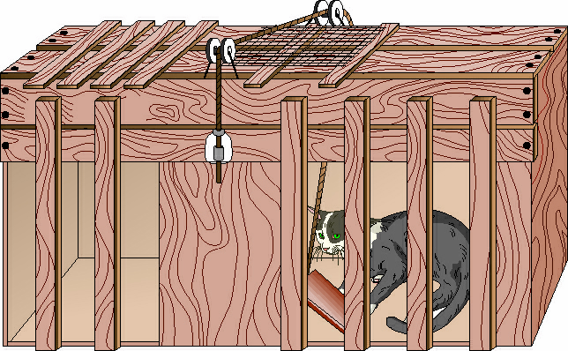
Thorndike’s Law of Effect
Thorndike discovered that when cats were placed in this type of puzzle box, they learned to push down on the wooden lever because it resulted in the satisfying consequence of opening the door to the box.

Slide 24
Based on the idea of Law of Effect – Thorndike
“Responses that produce a satisfying effect in a particular situation become more likely to occur again in that situation, and responses that produce a discomforting effect become less likely to occur again in that situation”
Operant conditioning is a method of learning that occurs through rewards and punishments for behavior.
Through operant conditioning, an individual makes an association between a particular behavior and a consequence

Slide 25
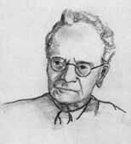
Skinner’s experiment
“The behavior is followed by a consequence, and the nature of the consequence modifies the organism’s tendency to repeat the behavior in the future.”
(Skinner)
“All we need to know in order to describe and explain behavior is this: actions followed by good outcomes are likely to recur , and actions followed by bad outcomes are less likely to recur.”
(Skinner, 1953)

Slide 26
Skinner used the term operant to refer to any "active behavior that operates upon the environment to generate consequences" (1953).
Operant behavior: occurs without an observable external stimulus
Operates on the organism’s environment

Slide 27
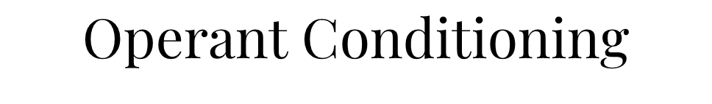

Slide 28
Behavior can be changed by the use of consequences which are given after a response.
Skinner identified three types of responses or operant that can follow behavior.
Neutral operants: responses from the environment that neither increase nor decrease the probability of a behavior being repeated.
Reinforcers: Responses from the environment that increase the probability of a behavior being repeated. Reinforcers can be either positive or negative.
Punishers: Response from the environment that decrease the likelihood of a behavior being repeated. Punishment weakens behavior.

Slide 29
Schedules of Reinforcement
A schedule of reinforcement is a program, or rule, that determines how and when the occurrence of a response will be followed by a reinforcer

Slide 30
Interval schedules
Reinforcement occurs after a certain amount of time has passed
Fixed Interval
Reinforcement is presented after a fixed amount of time
Variable Interval
Reinforcement is delivered on a random/variable time schedule

Slide 31
Ratio schedules
Reinforcement occurs after a certain number of responses
Fixed Ratio
Reinforcement presented after a fixed # of responses
Variable Ratio
Reinforcement delivery is variable but based on an overall average # of responses

Slide 32
Actions that are followed by reinforcement will be strengthened and more likely to occur again in the future – positive reinforcement/negative reinforcement
Positive reinforcement = (+) Add something
Negative reinforcement = (-) minus something

Slide 33






Application
Positive Reinforcements
Feedbacks
Opportunities
Flexible timings/work assignments
Negative Reinforcements
Reducing commute time
Reducing
workload
Reducing working hours

Slide 34
Activity Separate the positive and negative reinforcements from the list given
Competitive salary
Monetary bonus or raise
Changing a disliked team member
Employee discounts
Added vacation days
Quality health insurance/benefits
Allowed absences
Changing daily logs of a project to weekly logs

Slide 35
Punishment
Actions that result in punishment or undesirable consequences will be weakened and less likely to occur again in the future

Slide 36
Actions that are followed by punishment will be weakened and more likely to not occur again in the future – positive punishment/negative punishment
Positive punishment = (+) Add something
Negative punishment = (-) minus something
Used as a last resort = undesirable method

Slide 37
Activity
Design 3 punishments that can be used in an educational setup and/or a company

Slide 38
PUNISHMENT EXAMPLES
Deducting salary after every late
Marked absent for coming late
Unpaid leaves
Extra working hours due to failure in completing the assignments
Demotion from the current position
No bonuses

Slide 39
Shaping Behavior
Shaping is the process of teaching a complex behavior by rewarding closer and closer approximations of the desired behavior.
In shaping, you start by reinforcing any behavior that is at all similar to the behavior you want the person to learn.
Later, you reinforce only responses that are closer to the behavior you ultimately want to teach.
Finally, you reinforce only the desired response.
Each step moves only slightly beyond the previously learned behavior, permitting the person to link the new step to the behavior learned earlier.

Slide 40
Applications of Classical & Operant Conditioning

Slide 41
Advertisements
What was it based on? Classical or Operant?
The commercial displays heartbreaking images of animals in distress. The images of the abused animals evoke emotions of sympathy and compassion.

Slide 42
In classical conditioning, the advertiser attempts to get consumers to associate their product with a particular feeling or response, in the hope that the consumer will then buy the product.
Music that is happy and repetitive helps consumers to feel happy when they hear it. Consumers then associate the feelings of happiness with the product and may be more likely to buy the product.

Slide 43
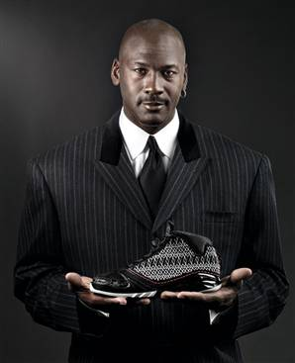
Michael Jordan promoting Air Jordan XX3 in 2008

Slide 44


Slide 45


Slide 46


Slide 47
Observational Learning

Slide 48
What is Observational Learning?
Observational learning occurs when an organism’s responding is influenced by the observation of others, called models.
Replicating others’ novel behavior through observation and imitation; also known as vicarious learning, modeling, or social learning.
It is based on the principle of modifying or adopting new behavior after observing another individual performing it.
The observer will either perform or avoid the behavior based on the consequence the model received after doing the behavior.

Slide 49
It was pioneered by Albert Bandura, who showed that conditioning does not have to be a product of direct experience.
Both classical and operant conditioning can take place through observational learning
Observational learning depends on the processes of attention, retention, reproduction and motivation.

Slide 50
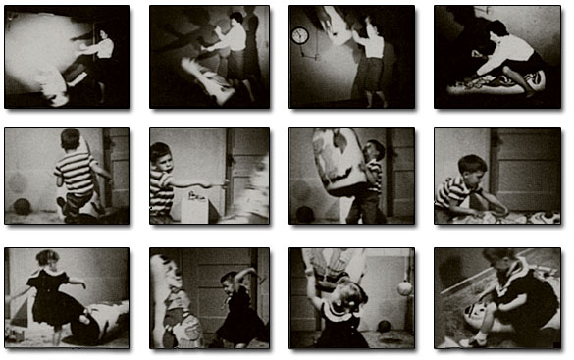
Bandura’s experiments on children using the Bobo Doll (Modelling)

Slide 51
Bandura distinguishes between the acquisition of a learned response and the performance of that response with the latter depending on reinforcement.
Observational learning can explain why physical punishment tends to increase aggression in children even when it is intended to do the opposite.

Slide 52
COGNITIVE MODEL

Slide 53
What is Cognitive Learning?
According to the cognitive perspective, the crux of learning lies in an organisms ability to mentally represent aspects of the world and then operate on these mental representations rather than on the world itself.
Learning develops from bits of knowledge and cognitions about the environment and how the organism relates to it

Slide 54
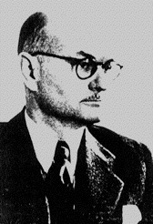
Edward Tolman
Early advocate of the cognitive approach to learning was Edward Tolman
Tolman is virtually the only behaviorist who found the Stimulus-Response theory unacceptable, because reinforcement was not necessary for learning to occur.
He felt behavior was holistic, purposive, and cognitive.

Slide 55
Cognitive Maps
Tolman’s research dealt with rats learning their way through complex mazes
In his view, a rat running through a complex maze was not learning a sequence of right-and-left running responses but rather was developing a cognitive map –
A mental representation of the layout of the maze

Slide 56
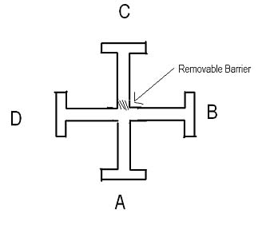
Maze Learning in Rats
Tolman would run rats through mazes
A was the starting point for the rats.
B was the goal at which he wanted them to reach.
He ran several experiments in which one would have the rats start at A and learn to run to B to get the food.
In doing so, they would have to turn right to get the food.
Once the rats learned, this he tried a different method.
He would start them at point C; if the rat turned right and went to section D, then they were not using cognitive maps, but instead he found they turned left and went to section B proving the use of cognitive maps.

Slide 57
Experiment on Latent Learning
Rats
Group 1
Group 2
Food on every trial of maze
No food given
Group 3
Food given after 10th day

Slide 58
Group 1
Learned the maze
Group 2
Wandered aimlessly
Group 3
Learned the maze during first 10 days
Reached food quickly
Time taken to reach food remained the same
Displayed learning when food was given
With food time to reach food box decreased drastically

Slide 59
This idea that rats don’t just learn movements for only rewards but instead learn even when there are no rewards suggests a
Latent Learning Theory

Slide 60
Latent Learning
Learning without reinforcement and is not immediately demonstrated when it occurs
Learning takes place, but is not displayed until a reward is given for a behavior that would demonstrate that the learning has occurred.

Slide 61
Wolgang Kohler
Was a Gestalt theorist
The term "Gestalt" refers to any pattern or organized whole.
The key concept in Gestalt theory is that the nature of the parts is determined by the whole - parts are secondary to the whole.
For example, when listening to music, we perceive a melody rather than individual notes, or when looking at a painting, we see the overall image rather than individual brush strokes.
Köhler emphasized that one must examine the whole to discover what its natural parts are, and not proceed from smaller elements into wholes.

Slide 62

Kohler’s theory suggested that learning could occur by sudden comprehension as opposed to gradual understanding.
This could occur without reinforcement, and once it occurs, no review, training, or investigation are necessary.
He said that insight learning is a type of learning or problem solving that happens all-of-a-sudden through understanding the relationships between various parts of a problem rather than through trial and error

Slide 63
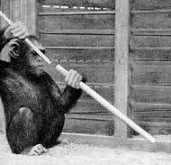
Kohler’s groundbreaking experiment involved one of his chimpanzees, Sultan.
Sultan learned to use a “stick” to rake in bananas outside of his cage.
Kohler placed the banana outside of the reach of just one stick and gave Sultan two sticks that could be fitted together to make a single pole that was long enough to reach the banana.
After fiddling with the sticks for an hour or so, Sultan happened to align the sticks and in a flash of sudden inspiration, fitted the two sticks together and pulled in the banana.

Slide 64
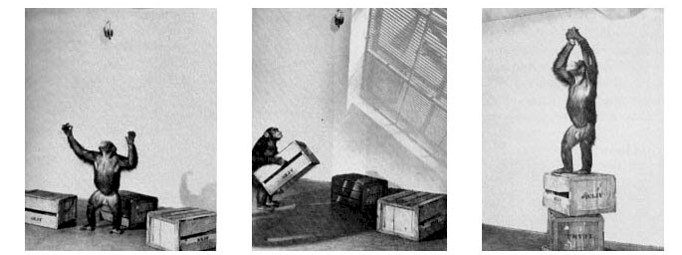
Kohler also demonstrated insightful learning in the 'box' problem, in the 'box' problem.
A banana was hung from the ceiling of a cage, which the chimpanzee could not reach ordinarily.
There were several boxes inside the cage. After some initial period the animal stacked several boxes, and stood on the top box to fetch the banana.

